Slide 1
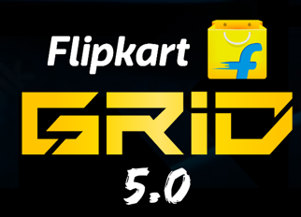

Loyalty and Rewards Program using Fungible Tokens
Team Name : Growcode

Slide 2



OUR TEAM - Growcode
Abhijit Singh (Leader)
Ritika Pandey
C Tanush
College : Army Institute of Technology
Computer Engineering - 2024
Computer Engineering - 2024
Computer Engineering - 2024

Slide 3
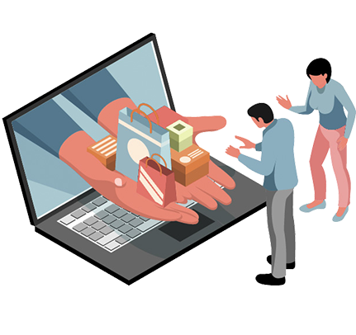
Problem Statement
User Engagement and Interaction
Token Generation and Management
Partnership Integration
Reward Redemption and Transparency:
Sub - Problems
Integration with Polygon Blockchain
Transaction and Token Tracking done on-chain
User-Friendly Interface Development

Slide 4

Our Model

Slide 5

Tech Stack & Architecture

Slide 6
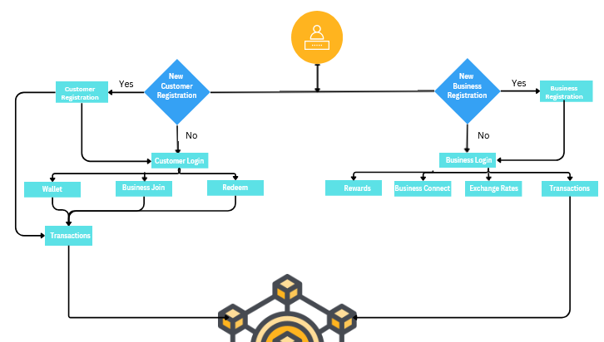
Flow Diagram
Blockchain

Slide 7
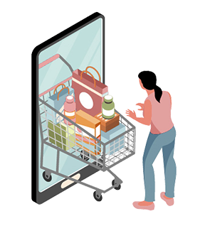

Use Cases
The loyalty program streamlines the settlement process between E-commerce platforms and brands.
It generates loyalty tokens for customers based on their actions such as purchases, referrals.
Ability for partners to issue their own loyalty tokens. Consistent token issuance and redemption standards. Expansion of the program's scope and offerings.
Transparent governance recorded on the blockchain. Flexibility to adjust tokenomics.
Clear overview of earned loyalty points and rewards. Access to transaction history for transparency.

Slide 8

Features
Loyalty points are earned and stored as blockchain - based fungible tokens ensuring transparency and security.
Fungible Tokens generation and well defined tokenomics.
Decentralized governance mechanism to manage day-to-day operations.
Automated settlement process transaction between brands and E-commerce platform.
Redemption of Rewards and transaction Transparency.
User-Friendly Interface.
Access to transaction history.
Highly Scalable and better performance.
Decaying mechanism on fungible token.
Simple to use
“No need for Prior knowledge of BlockChain” .

Slide 9
Limitations
Future Scope
Running on a public blockchain network poses limitations in terms of security, data privacy, and scalability for our program.
Blockchain Private Network will ensure more security and data privacy, reinforcing more user trust and confidentiality.
Cloud-Based Loyalty Program will streamline rewards, ensuring a seamless and customizable experience.
Gamification of App will amplify user engagement and enjoyable experience.

Slide 10
